Slide 1
Welcome to Arabic Level I by Kurzban

Slide 2

Lesson 5: الدرس الخامس
Objectives:
Review
Identify long and Short Vowels
Practice
Summary
Flash card

Slide 3
Lesson 5: Do Now:
Review short and long vowels
رَ + ت +ي + ب=
ث +ا +بِ +ت =
زِ + رْ + ي + ا + ب =
ي + د +ا + ن =

Slide 4
Arabic Alphabet: practice connecting them
ثَ +ب + ب +تَ=
ب + يْ +نَ =
=يَ + بُ + ثُ +ث
ب + يْ+ت =

Slide 5
Lesson 5: Review short & long vowels
Remember that sukoon, it indicate that no vowel sound follows that letter such as {Stay & drag}
Work backwards: Identify each letter
____ + ___+ ____ تِبْن =
بُنّ =
أنا =
أنْتِ =
أنْتَ =

Slide 6
Working with Hamza
Alif is unique amongst Arabic letters because it does not have a definite sound.
There are two main ways an Alif is used:
1] To form the long vowel a OR
2] To carry a short vowel. If a word begins with a short vowel, the vowel sign cannot simply hang in the air before the next letter.

Slide 7
Hamza
(ab)= أَب
(udh) = أُذ
(in) = إِن
The small shape (ء) is known as hamza.

Slide 8
Mini practice
Practice saying these letters with their vowels.
1] إِذْن 3] أُذْن
2] إِيران 4] أَنْتَ/ أَنْتِ

Slide 9
Make sure you write the previous examples in your note book
Lets examine this !
أنت جميلة!
You are beautiful!(F)

Slide 10
Make sure you write the previous examples in your note book
Lets examine this !
أين هو بيتك
Where is your house? (M)

Slide 11
Make sure you write the previous examples in your note book
هل تناول الغداء اليوم؟
Have you had lunch today?

Slide 12
Make sure you write the previous examples in your note book
أنا أحب اللغة العربية
I love Arabic

Slide 13
Literature
In 1988 Naguib Mahfouz, an Egyptian writer, won the Nobel prize for literature. He died in 2006 at the age of 94. The prize created international interest in Modern Arabic literature. Mahfouz himself has written many novels which can be found outside the Arab World both in the original Arabic and in translation.

Slide 14
Literature
Your mission is to find out more about this novelist and list all his achievements including any books, stories…etc..
Your assignment (2-3 paragraphs) must be typed with proper headings, pictures if necessary… and emailed to me within one week of today’s date.
This assignments is worth 20 points.

Slide 15
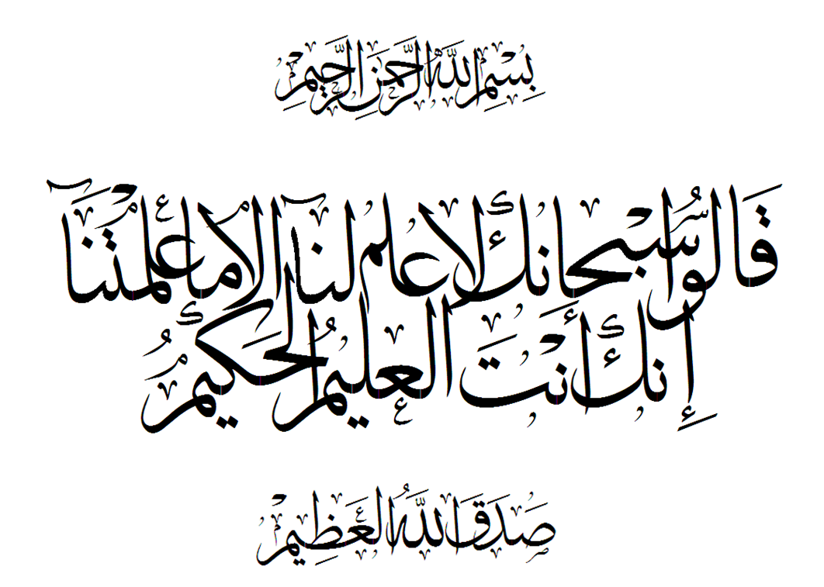
Summary
Examine these words and identify the vowels that we have discussed by circling them and list their names

Slide 16

Review
Review
Make your flash card for this lesson
Questions????

